Slide 1
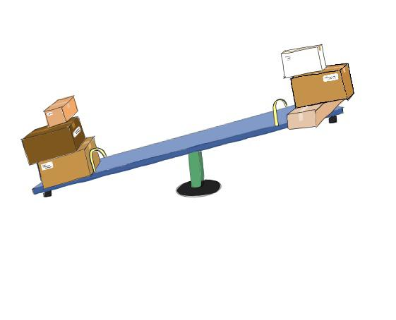
Seesaw pitch
Duncan Do S3718718
Sher Anne Wong S3703019

Slide 2
Who are we and what do we do?
Seesaw is founded by Sher Anne Wong and Duncan Do.
We are a peer-to-peer marketplace that connects locals who want to buy goods from overseas that are unattainable due to shipping difficulties to travelers who are able and willing to ferry the items to the locals.
Our goals
Connecting people around the world
Giving people the opportunity to indulge in their favorite goods

Slide 3

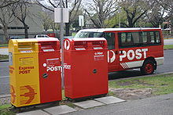
How did this idea come about?

Slide 4
Not new, but better!

Slide 5
Potential Profitability of seesaw
The success of similar services such as UberEATS, Deliveroo, Easi, etc.
People prefer convenience and efficiency
Globalization is our best friend
Popularization of online shopping
Bridging the gap between supply and demand everywhere

Slide 6
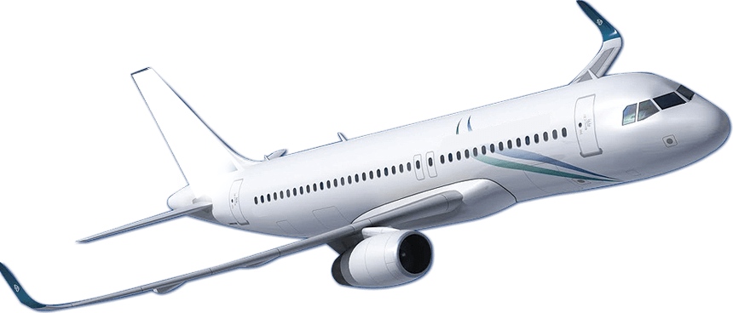
Target market
Two-fold
Product ferries
Product receivers

Slide 7
Product ferries
People who frequently travel
E.g. Backpackers
Travelers with extra baggage space
Comes at no extra cost to them

Slide 8

Product receivers
Frequent online shoppers
People who like to follow international trends
Buyers who do not want to experience shipping delays
Buyers who do not want to wait for international releases

Slide 9
Will people trust our service platform?
Will people pay for this service?
Example: Malaysians shopping in Singapore for the latest iPhone
Example: Success of food delivery applications (UberEATS)
People value convenience and speed
Source: Strait Times

Slide 10

Competitors analysis
Airfrov (Singaporean-based)
Grabr (American-based)
Our challenges:
Established markets
Reputation
Overcoming those challenges:
Offering dynamic pricing strategies
Product screening
Advantage of having an isolated market

Slide 11
team knowledge, expertise and advantages
Sher
Business degree
Family built on startup businesses
Frequent traveler
Duncan
Computer Science degree
Family connections

Slide 12
External expertise required
Financial
Legal
Business

Slide 13
Financial plan
Payments
Accounting | gst | 410 | 410 | 410
Advertising & promotion | gst | 3000 | 1500 | 550
Insurance |  | 3200 | 0 | 0
Lease / Rent |  | 760 | 760 | 760
Legal costs |  | 1000 | 0 | 0
Business name registration |  | 85 | 0 | 0
Potential hazard expenses |  | 130 | 0 | 0
Computers | gst | 4000 | 0 | 0
Printing, stationery & postage | gst | 250 | 50 | 50
Website |  | 54 | 54 | 54
Wages | gst | 5000 | 5000 | 5000
Superannuation |  | 475 | 475 | 475
Telephone - Landline, mobile, ISP |  | 190 | 90 | 90
Workcover |  | 50 | 50 | 50
Plant & Equipment (Capital) |  | 100 | 0 | 0
GST Paid on Inputs |  | 1266 | 696 | 601
GST Paid to ATO |  |  | -1128 | -511
Total Payments |  | 19970 | 7957 | 7529
Estimate cost for the first 3 months - $36,000
Includes rent, insurance, advertising, legal costs, etc.
Resource acquisition
Crowdfunding websites
Networking events
Dragon’s Den

Slide 14
Thank you
Duncan Do S3718718
Sher Anne Wong S3703019

